Slide 1
IOT based hybrid health monitoring device
Shri Shankaracharya Institute of Professional Management & Technology, Raipur
Minor Project Report on
CSE 7th Semester
Department of Computer Science and Engineering,
Batch 2018-2022
Session July – Dec 2021
Presentation Date: 08/11/21
Project Group Members:
TIRNA MITRA
TANMAY MITRA
Project Guide
Dr. J P Patra
(Hod, CSE)

Slide 2
Project Overview
IoT technology spread its wings to the Medical sector to save many lives. The aim of developing this project is to monitor the health condition of a person anywhere and send the information to a specialized doctor to check up. Using this frequency of visiting doctor decreases. We developed a project using Wearable sensors with solar harvesting and Bluetooth low energy transmission that creates a wireless body area network (WBAN). Using this project you can detect the heartbeat, Blood pressure, temperature, etc., All these reports can be used for analyzing a person’s health.

Slide 3
Application Area
Why did you opt to work on this project?
- We choose this project in order to facilitate instant health check up, without having a physical appointment with the doctor.
What are the Applications and Benefits of this project?
- This system is very effective in monitoring a person’s health continuously because it is fully automated. It can be tested very easily with any person. This system is a very good example of remote health monitoring.
Who are the End Users of this project?
- This device can be used by any age group above the teen age.

Slide 4
Proposed System
In this project, a system for 24×7 human health monitoring is designed and implemented.
In this system, the Node Mcu is used for collecting and processing all data.
Different sensors are used for measuring different parameters.
All this data is uploaded to thing speak for remote analysis
An ESP8266 module is used for connecting to the internet
A solar power system is provided for powering all the sensors

Slide 5
Project Requirements (Developer)
Software’s Required ​
Arduino IDE​
Hardware Required​
Arduino uno
Heartbeat sensor (Lm358)
Temperature sensor (Dht 11)
Solar Panel

Slide 6
Project Requirements (End User)
Hardware Requirements :- ​
The device
Smart phone(for its application to run)​
​

Slide 7
Project Code
#define USE_ARDUINO_INTERRUPTS true
#include <PulseSensorPlayground.h>
#include "DHT.h"
#define DHTTYPE DHT11
#define BLYNK_PRINT Serial
#include <ESP8266WiFi.h>
#include <BlynkSimpleEsp8266.h>
int PulseSensorPurplePin = A0
int LED = D2; // The on-board Arduion LED
int Signal; // holds the incoming raw data. Signal value can range from 0-1024
int Threshold = 550; // Determine which Signal to "count as a beat", and which to ingore.
#define dht_dpin D5DHT
dht(dht_dpin, DHTTYPE); // char
auth[] = "SHyaHSL-Au-mwAYf99V2kF7LUz_Sbi9l";
char ssid[] = "iPhone 13";
char pass[] = "qwerty@123";
char auth[] = "g8P9tJg9FIZKiMFfvkgB_DpNvRkCpMoz";
char ssid[] = "Y011110D N/w";
char pass[] = "AT89CY52";
float h;
float t;PulseSensorPlayground pulseSensor; // Creates an instance of the PulseSensorPlayground object called "pulseSensor“
void setup(void){ dht.begin();
Serial.begin(115200);
pinMode(LED,OUTPUT); // pin that will blink to your heartbeat! Blynk.begin(auth, ssid, pass

Slide 8
Blynk.notify("System Ready..!!");
delay(3000);
Serial.println("Humidity and temperature\n\n");
delay(700);
Configure the PulseSensor object, by assigning our variables to it. pulseSensor.analogInput(PulseWire);
pulseSensor.blinkOnPulse(LED13);
pulseSensor.setThreshold(Thresholdif (pulseSensor.begin()) { Serial.println("We created a pulseSensor Object !");
}}void loop() {
Signal = analogRead(PulseSensorPurplePin);
Serial.println(Signal);
h = dht.readHumidity();
t = dht.readTemperature();
Blynk.virtualWrite(V0,h);
Blynk.virtualWrite(V1,t);
Blynk.virtualWrite(V2,Signal);
Blynk.virtualWrite(V3,myBPM);
Serial.print("Current humidity = ");

Slide 9
Serial.print(h);
Serial.print("% ");
Serial.print(" temperature = ");
Serial.print(t);
Serial.println("C ");
int myBPM = pulseSensor.getBeatsPerMinute();
if (pulseSensor.sawStartOfBeat()) if "a beat happened". Serial.println("♥️ A HeartBeat Happened ! ");
Serial.print("BPM: ");
Serial.println(myBPM);
myBPM. } delay(20); }

Slide 10
Project Flow Diagram
START
Device gathers solar power in cell
Sensors receive data
Data received is compared with the critical value
Continues receiving data
No
Yes
Sends info. to the user

Slide 11
Data Flow Diagram
Start
Sensors receiving data
Blynk

Slide 12
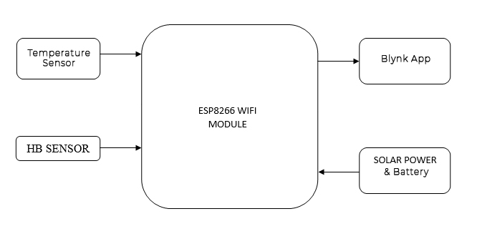
Block Diagram

Slide 13
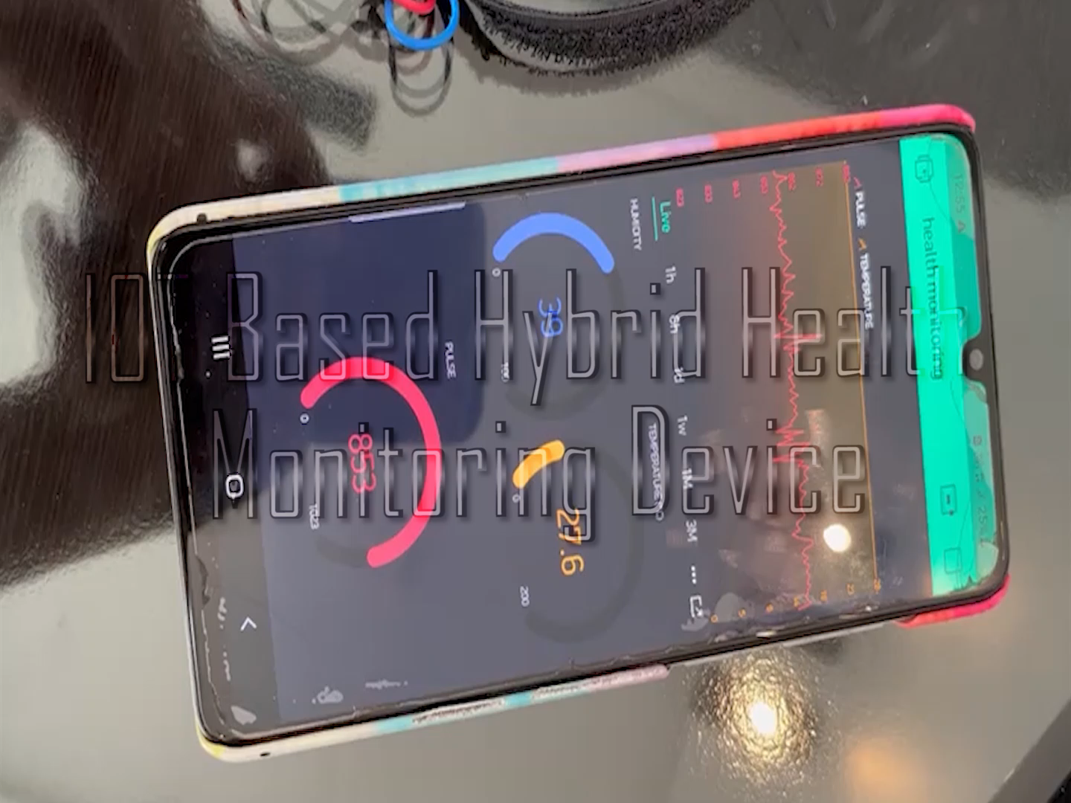
Result achieved till date

Slide 14
How this Project is going to help your Institute or Society or any specific group of people?
Health is the most important part of any human’s life without health it is useless to any treasure of life. Most humans live a busy life in which going to a doctor for weekly or even monthly checkup is an impossible task. Without monitoring your health it is not possible to whether you are a healthy or sick person. This problem leads to the design of a product which monitors your health every day without going to a doctor. Here, a system is designed as a prototype for monitoring alerting based on the health of a person. This system is fully automated little or no human help is needed. Any doctor can monitor this person from anywhere through the internet.
14

Slide 15
References
Web Resources
https://www.healthline.com/health/best-blood-pressure-monitor
https://circuits-diy.com/heartbeat-sensor-circuit-using-lm358-electronics-projects/
https://www.elprocus.com/ad8232-ecg-sensor-working-and-its-applications/

